Slide 1
Child Welfare Training Chatbot Child Abuse and Neglect Training in Texas
Early Childhood Care and Educators, Family Services Professionals
June 24, 2026

Slide 2
Child Abuse and Neglect Training in Texas Agent
A one stop, shop for individuals and organizations working with young children in Texas to find updated information, law, regulations, and professional development opportunities related to mandated reporting of child abuse and neglect.

Slide 3
Overview
Audience: Early Childhood Care and Education and Family Services professionals and organizations in Texas
Challenge: Finding up-to-date, easily accessible information on mandated reporting in one central repository.
Solution:
A tool that has centralized, authoritative, and reliable information and training for the key audience to access the knowledge, information, and expertise to respond to incidents of child abuse and neglect.

Slide 4
RAG Documents
Reporting abuse, neglect, and exploitation of a child in Texas
Mandatory reporting in Texas
Contact information for DFPS
Notes, files, or documents for reporting
False reporting
Good faith reporter
Requirements under Texas Family Code 261.101 through 261.110

Slide 5
Web Search Enquiries or Questions
Federal, State, and local laws and policies on child abuse and neglect
Mandatory reporting of child abuse and neglect in Texas
Data and Reports on child abuse and neglect
Texas child centered care
Child safety and prevention
Adoption and foster care
Child Investigations
Child Services

Slide 6
Multi Agents System
Orchestrator Agent
Route user Queries to appropriate agents
Ensures responses follow training objectives and compliance rules
Researcher Agent
Semantic search across knowledge bases
Retrieves accurate, up-to-date knowledge
Reviewer Agent
Ensures responses are Accurate, Policy-compliant, and Safe/appropriate
Alignment with Texas State Regulations

Slide 7
Decision Logic
Read the question carefully
Determine if it's about child neglect or abuse laws and regulations in Texas→ Use search_documents first
If it needs current/external information → Use web_search
If question is ambiguous, try search_documents first, then web_search if needed
NEVER make up information - always cite sources

Slide 8
Response Guidelines
Be friendly, professional, and helpful
Provide accurate information based on search results
Cite where information came from (knowledge base or web source)
If you find relevant documents, quote key information
If you cannot find information, be honest about it
Suggest alternatives if the answer isn't available

Slide 9
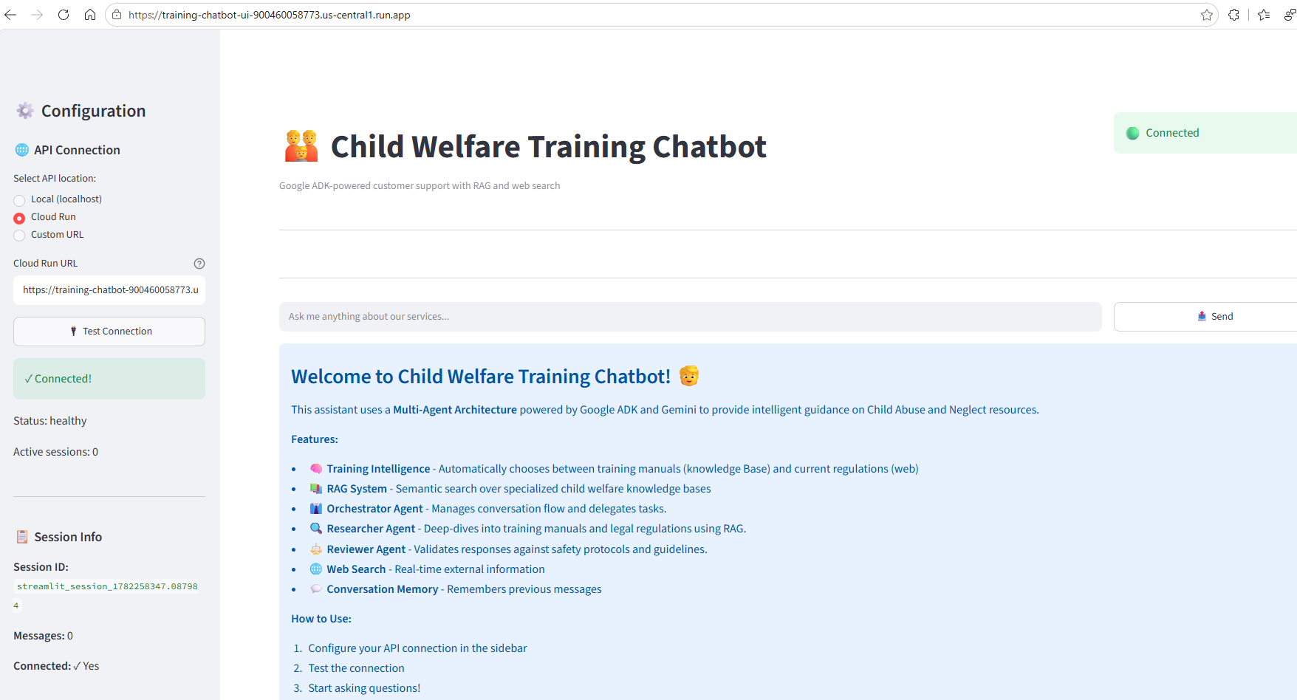
ChatBot UI → https://training-chatbot-ui-900460058773.us-central1.run.app ChatBot Code → https://training-chatbot-900460058773.us-central1.run.app

Slide 10
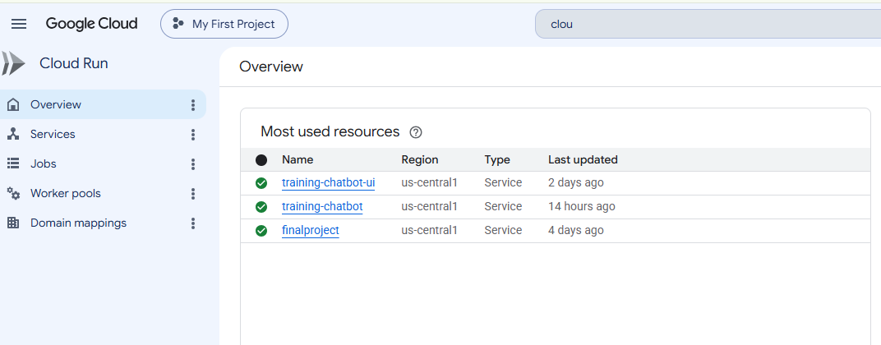
Cloud Run - Services

Slide 11
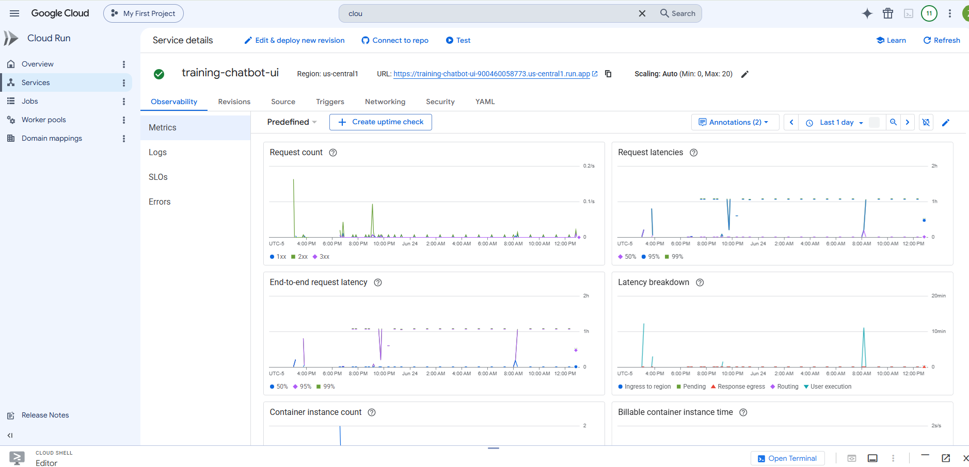
Cloud Run – training-chatbot-ui

Slide 12
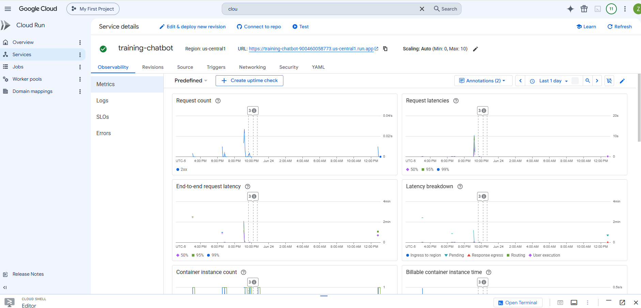
Cloud Run – training-chatbot

Slide 13
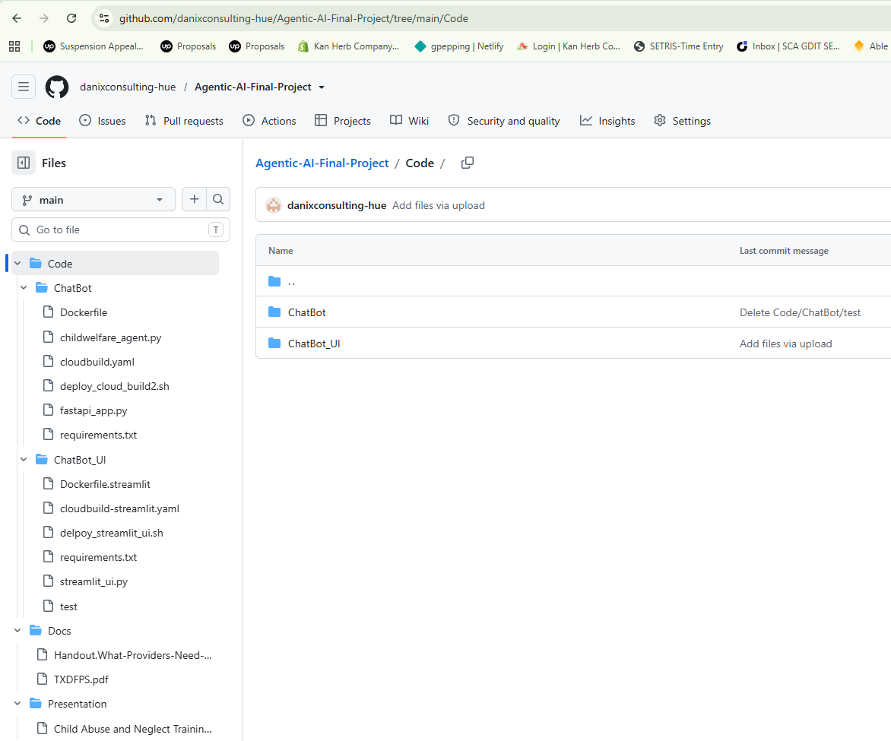
Github link →https://github.com/danixconsulting-hue/Agentic-AI-Final-Project

Slide 14
Github link →https://github.com/danixconsulting-hue/Agentic-AI-Final-Project

Slide 15
Decision Framework
Prioritize internal knowledge base
Use external sources only when needed
Ensure verifiable and cited responses

Slide 16
Governance & Compliance
Aligned to Texas DFPS guidelines
Audit-ready and traceable outputs
Responsible handling of sensitive content

Slide 17
Value Proposition
Improves trust and accuracy
Supports mandated reporting training
Modern, scalable AI architecture

